Slide 1
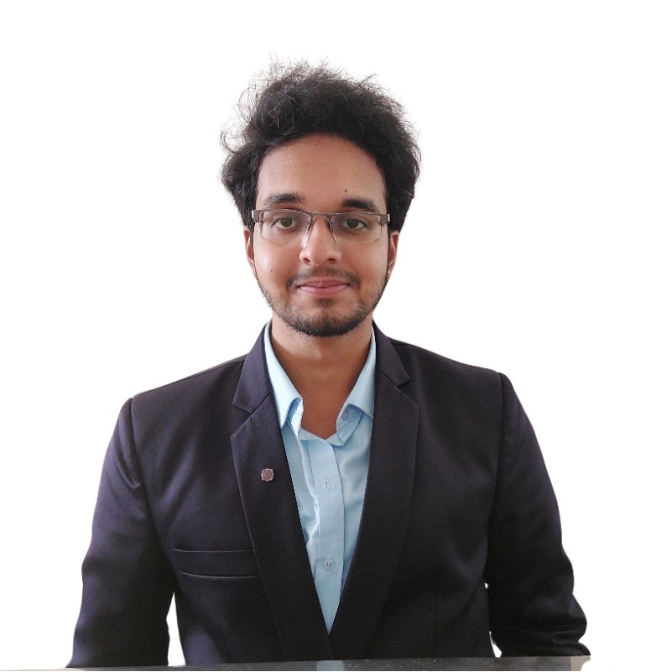






Allianz Experience
Skills
Findings Tracking Dashboard
Developed an Audit Findings Monitoring Dashboard tracking 150+ open findings with daily refresh, deadline-based prioritization, and risk indicators. Improved audit monitoring for 30+ auditors, reducing manual Excel tracking by 50–70% and significantly cutting review time.
Data Analytics support of Internal Audits
Developed Power BI dashboards to enable data-driven audit testing, integrating multiple data sources and aligning outputs with audit analytics requirements.
Power BI
Python
Generative AI
Machine Learning
Polamraju Sai Nithin
ASSOCIATE ANALYST (BUSINESS ANALYTICS)
Sai.nithin@allianz.com
Data Analysis
1.7
years
POC
FastAPI
Sai Nithin is a seasoned expert in the field of data science, with a keen interest in machine learning, big data analytics, and dashboard creation. He has completed internships focused on image forgery detection and natural language processing (NLP). Additionally, I independently managed client project tasks, consistently delivering results in a professional manner.
Ask me about: Power BI reporting, Gen-AI , LLM’s , FastAPI , AI Agents , visualizations.
Timesheet Analysis Dashboard
Developed an end-to-end Power BI solution to monitor timesheet compliance, identifying 40–60 auditors with missing entries and reducing manual follow-ups by 70%. Delivered clear visibility into audit time allocation, deadline overruns, and post-deadline effort.
Broker Prioritization POC
Developed a broker prioritization model using Cytora data, extracting and engineering key features to improve risk assessment and support data-driven underwriting decisions.
Prompt Engineering
Power Automate
Languages
English
Location: Trivandrum, INDIA
Gen AI POC
Worked on MCP Concept to intergrade it with financial Analyst Agentic model.
Telugu
Tools Used :-
Hindi

